Slide 1
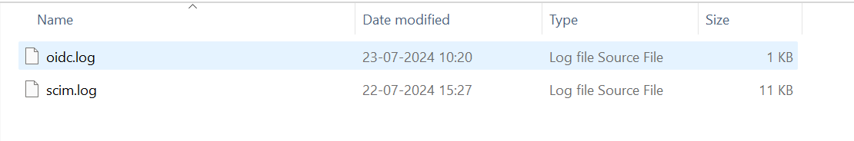
TDP, TDS UI AND LOGIN ISSUES
For TDP, TDS login issues always check their log files for different issues
Check the IAM log files
D:\Talend\iam\data\logs
Check this oidc and scim logs are generating correctly.

Slide 2
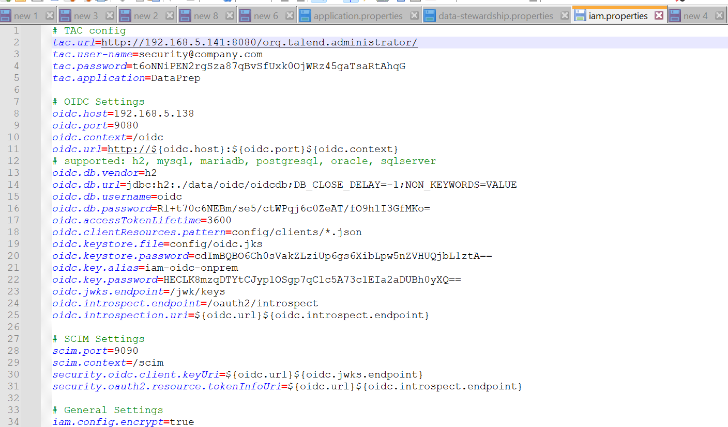
*Check the TAC url in Iam.properties file
D:\Talend\iam\config

Slide 3
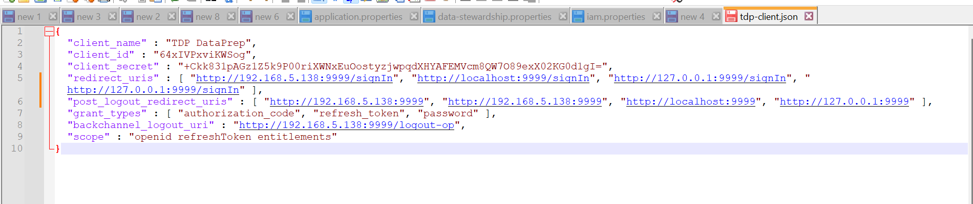
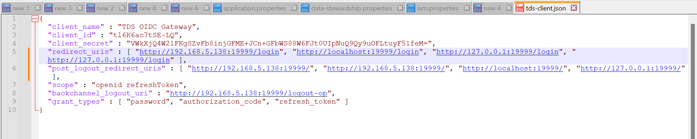
*If we are facing to access or login in the UI of TDP , TDS change the below files
tdp-client.json
tds-client.json
D:\Talend\iam\config\clients

Slide 4
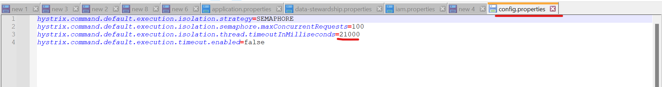
*Check the Talend Data prep logs
app.log
audit.log
D:\Talend\dataprep\data\logs
All the logs in the app.log should generate correctly.
*Check the configuration file
D:\Talend\dataprep\config
application.properties
config.properties

Slide 5
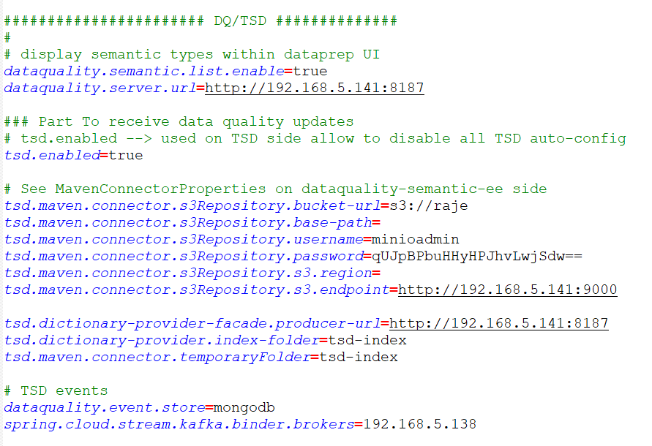
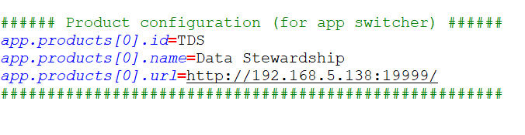
*Check the Ip addresses and mongodb parameters
*Check the DQ parameters if we installed MinIO separately check the parameters.
*Redirection URL parameter.

Slide 6
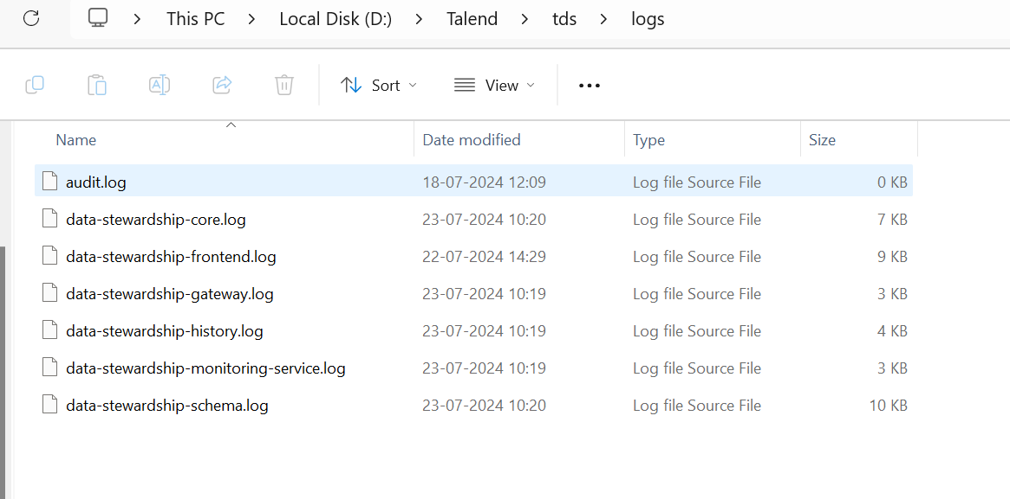
*Check the Data stewardship Logs
D:\Talend\tds\logs

Slide 7
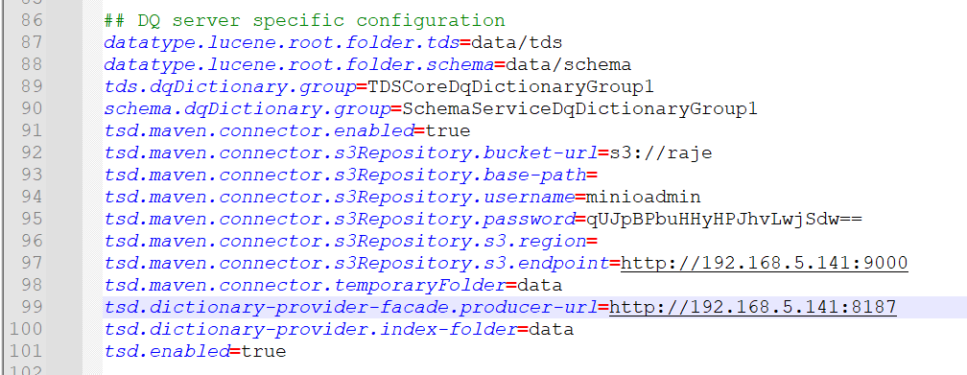
*Check the Data stewardship configuration files.
D:\Talend\tds\config
data-stewardship.properties
*Check the DQ configurations

Slide 8
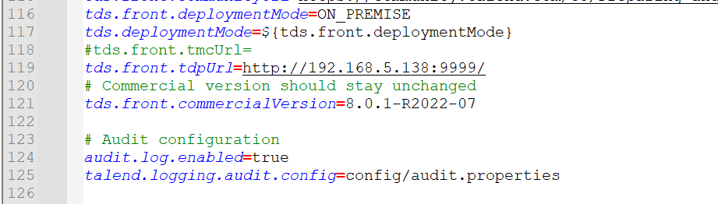
*Redirection url configuration

